Slide 1

ICS 474 Project: Uber Data Analysis
analysis of Uber trip data, exploring patterns in urban mobility. Our project covers data understanding, preprocessing, modeling, and visualization to derive insights from transportation data.
Fares Bahamdan
201943050
Abdullah Altassan
201969370
Abdulaziz Almesfer
201918130

Slide 2

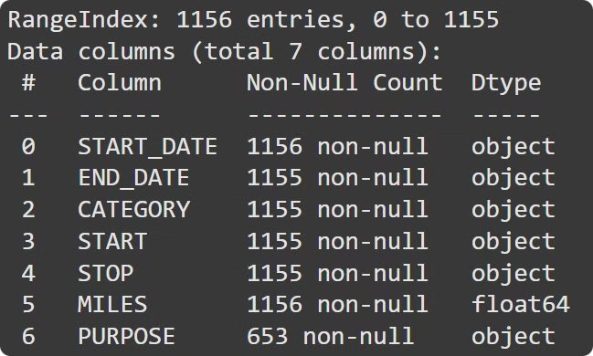
Dataset Overview
1
Source
Uber dataset with 1,155 rows and 7 columns.
2
Focus
Urban mobility and transportation efficiency insights.
3
Key Features
Trip dates, categories, locations, miles, and purposes.

Slide 3
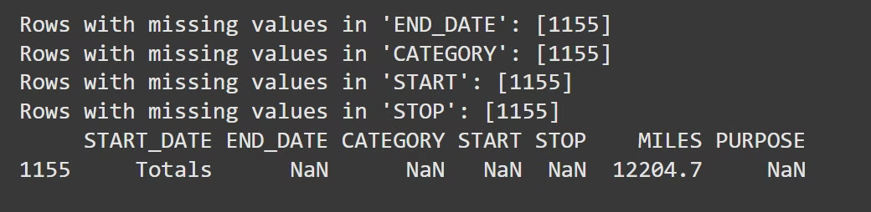
Data Exploration
Missing Values
Duplicates
Statistical Summary
5 out of 7 categories have missing values. Purpose column affects model prediction.
Abnormal duplication in START_DATE and END_DATE. One whole row duplicated.
Miles show large variety. Possible outliers indicated by high max relative to 75th percentile.

Slide 4
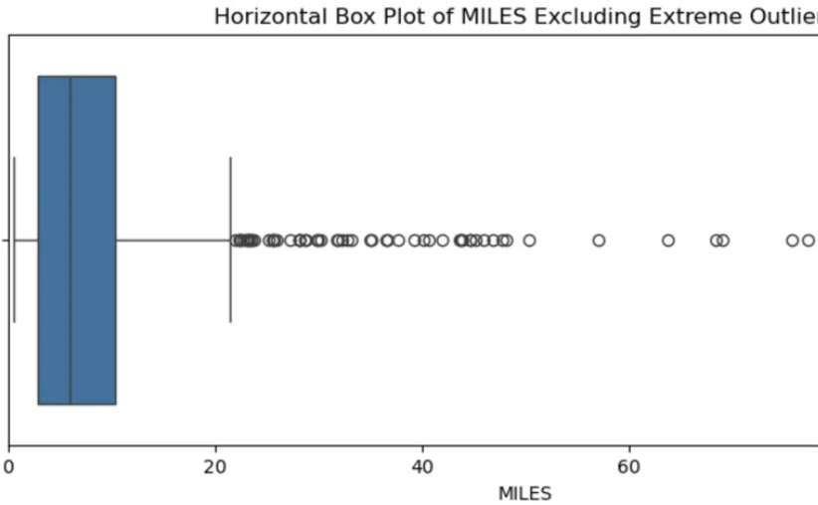
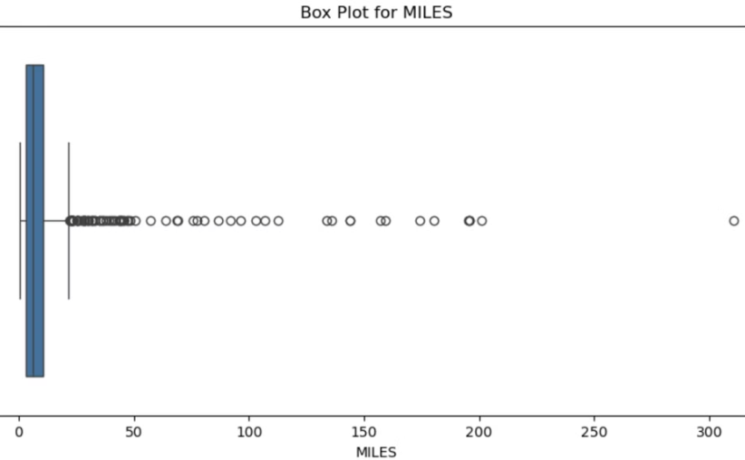
Data Distribution
Miles Distribution
Outlier Detection
Box plot shows distribution of miles in quartiles, including outliers except extreme ones.
Scatter plot displays all outliers, including extreme ones, in the miles data.

Slide 5

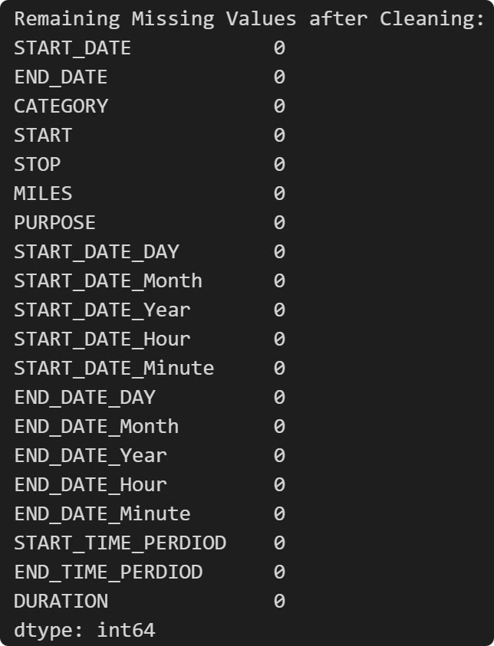
Data Preprocessing
1
Handling Missing Data
Filled missing values in PURPOSE column with "unknown" to preserve data integrity.
2
Encoding Categorical Variables
Used one-hot encoding for CATEGORY, START, STOP, and PURPOSE.
3
Feature Scaling
Applied scaling to MILES and DURATION for distance-based algorithms like KNN and SVR.

Slide 6

Modeling Approach
Algorithm Selection
Chose Gradient Boosting Regressor for its high predictive power and ability to handle diverse data patterns.
Data Splitting
Used 80% for training and 20% for testing to simulate real-world scenarios.
Model Training
Adjusted hyperparameters using GridSearchCV for optimal performance.
Evaluation Metrics
Used R², MAE, and RMSE to assess model performance comprehensively.

Slide 7

Model Performance
Model
R² Score
MAE
RMSE
Gradient Boosting
0.94
2.85
3.63
Random Forest
0.93
3.18
3.92
Gradient Boosting Regressor outperformed other models, explaining 94% of variability in MILES with lowest error rates.

Slide 8





Feature Importance
START
Origin of the trip is the most influential feature.
CATEGORY
Trip type (business/personal) significantly impacts distance.
PURPOSE
Reason for the trip plays a crucial role in determining miles.

Slide 9
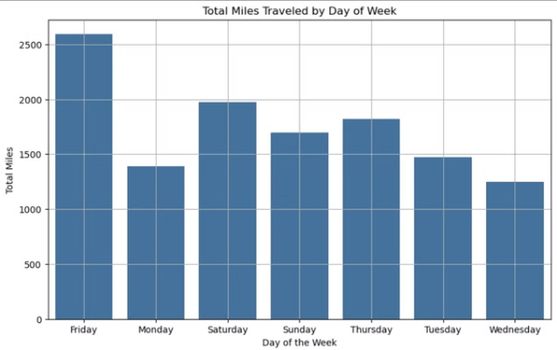
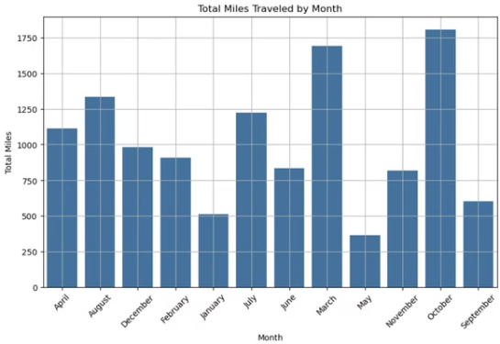
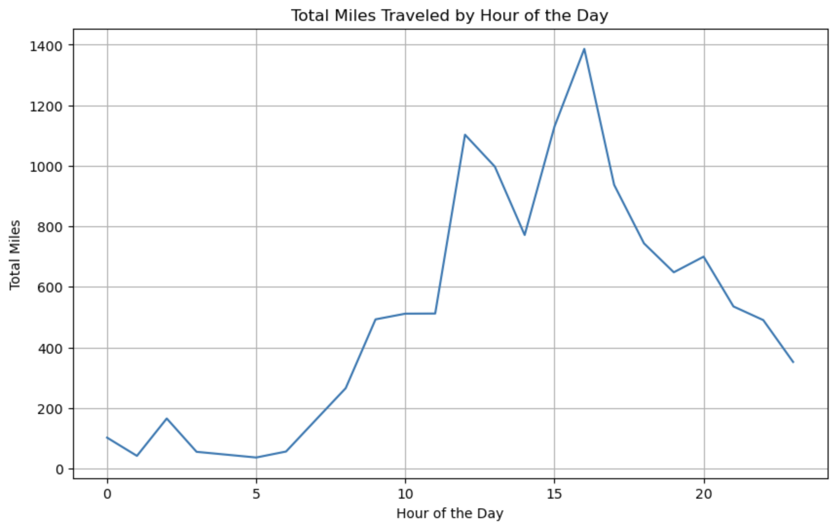
insights

Slide 10

Conclusions and Future Work
1
Key Findings
Gradient Boosting model effectively predicts trip distances based on start location, category, and purpose.
2
Limitations
Model performance varies for different trip types and distances.
3
Future Improvements
Incorporate more features, explore advanced algorithms, and gather more diverse data for better predictions.

